Slide 1
SRI SIVASUBRAMANIYA NADAR COLLEGE OF ENGINEERING
SSN RESEARCH INTERNSHIP 2022
Detecting Disaster Relevant Events By Investigating Microblog Tweets
PROJECT ID: IT09
MENTOR : Dr S Sasirekha B.E., M.E., Ph.D.
ROSHAAN S II YEAR IT, SVCE

Slide 2
PROBLEM STATEMENT
To detect disaster-relevant events by investigating microblog tweets.
Objective:
To collect a high volume of streaming data and online logs in real-time from multiple sources using Tweepy and Twitter streaming API.
To mark the location of the event using K-means and DBSCAN Algorithm.
To geotag it using Map API which provides spatial context.

Slide 3
DATA COLLECTION
Real-time data is collected from Twitter.
Twitter API is used which enables programmatic access to Twitter in unique and advanced ways.
This Twitter API returns data in JSON format.
It contains attributes like created_at, full_text, screen_name, location, follower_count, like_count, etc…
API key has to be obtained from the Twitter developer platform to use Twitter API.

Slide 4
DATA COLLECTION
Tweepy is an open source library in python which is used for accessing Twitter API.
Using Tweepy important attributes like Text, location, user, created_at, etc are extracted.
This extracted data is stored in DataFrame which is later transformed into a CSV file by making use of the pandas library in Python.

Slide 5
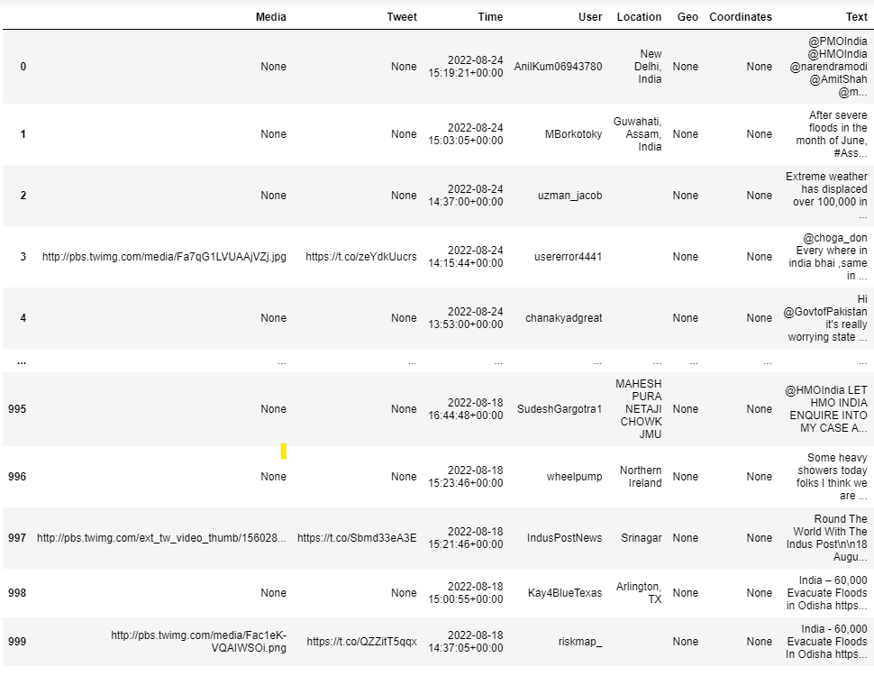
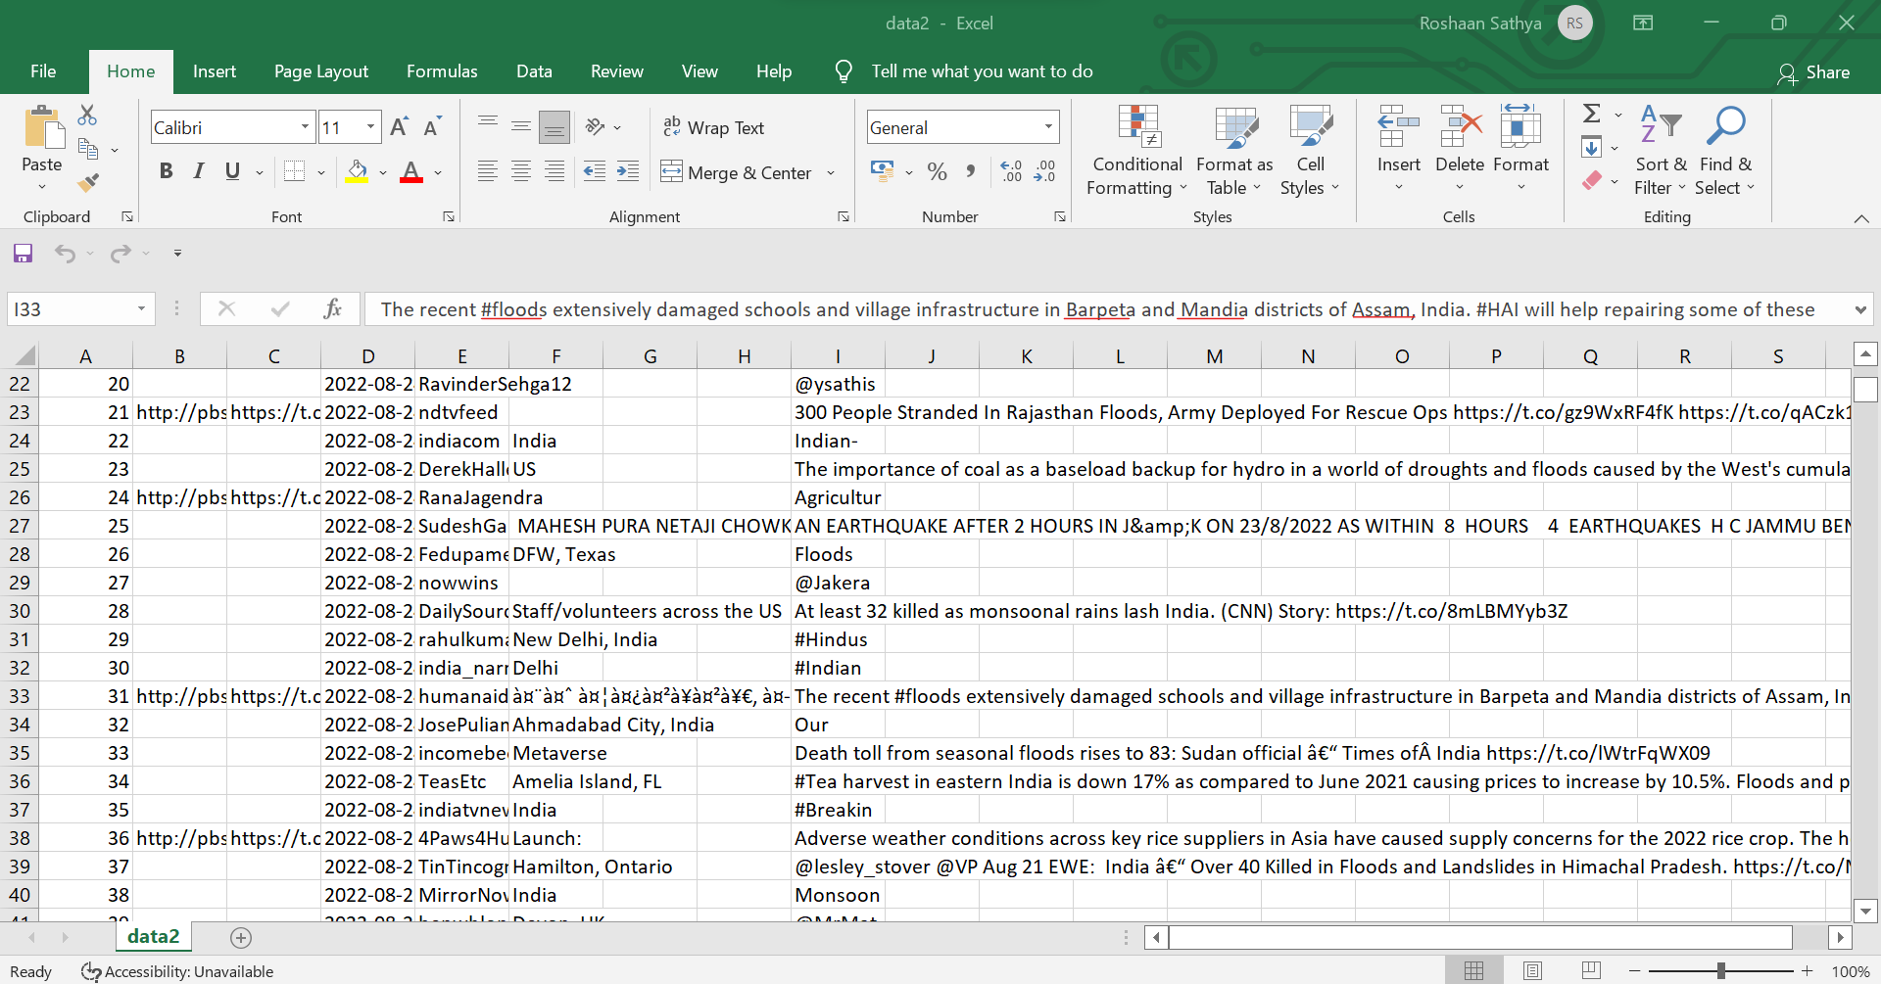
DATA COLLECTION

Slide 6
RESEARCH METHODS
The Twitter data extracted is unstructured data. It contains symbols, emojis, etc.
The data is structured using Natural Language Tool Kit (NLTK).
The data is cleaned by removing special symbols, and stopwords, and then text data is converted into lowercase for better analysis.
Words representing the location of the event are obtained by iterating the text and comparing it with a list of Cities and towns in India.
Dataframe is created with these words and their frequency in tweet data.

Slide 7
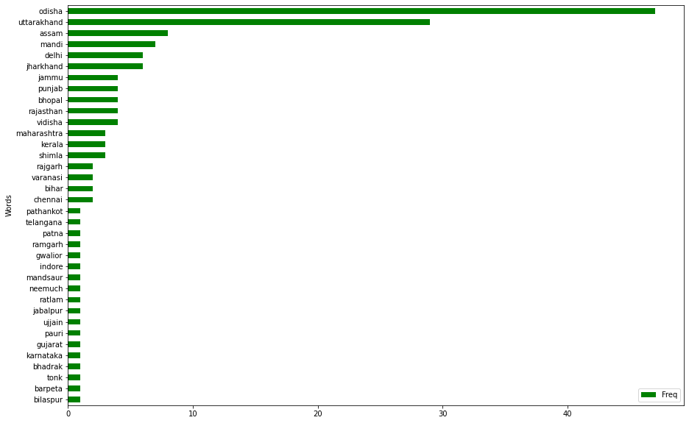
RESEARCH METHODS

Slide 8
RESEARCH METHODS
TfidfVectorizer is used to transform the text into Vectors.
Then, the Clustering algorithm is used to obtain clusters.
K-means clustering and DBSCAN clustering algorithm are used to cluster disaster locations and obtain the specific regions.
Scatter plot is plotted to represent clusters.

Slide 9
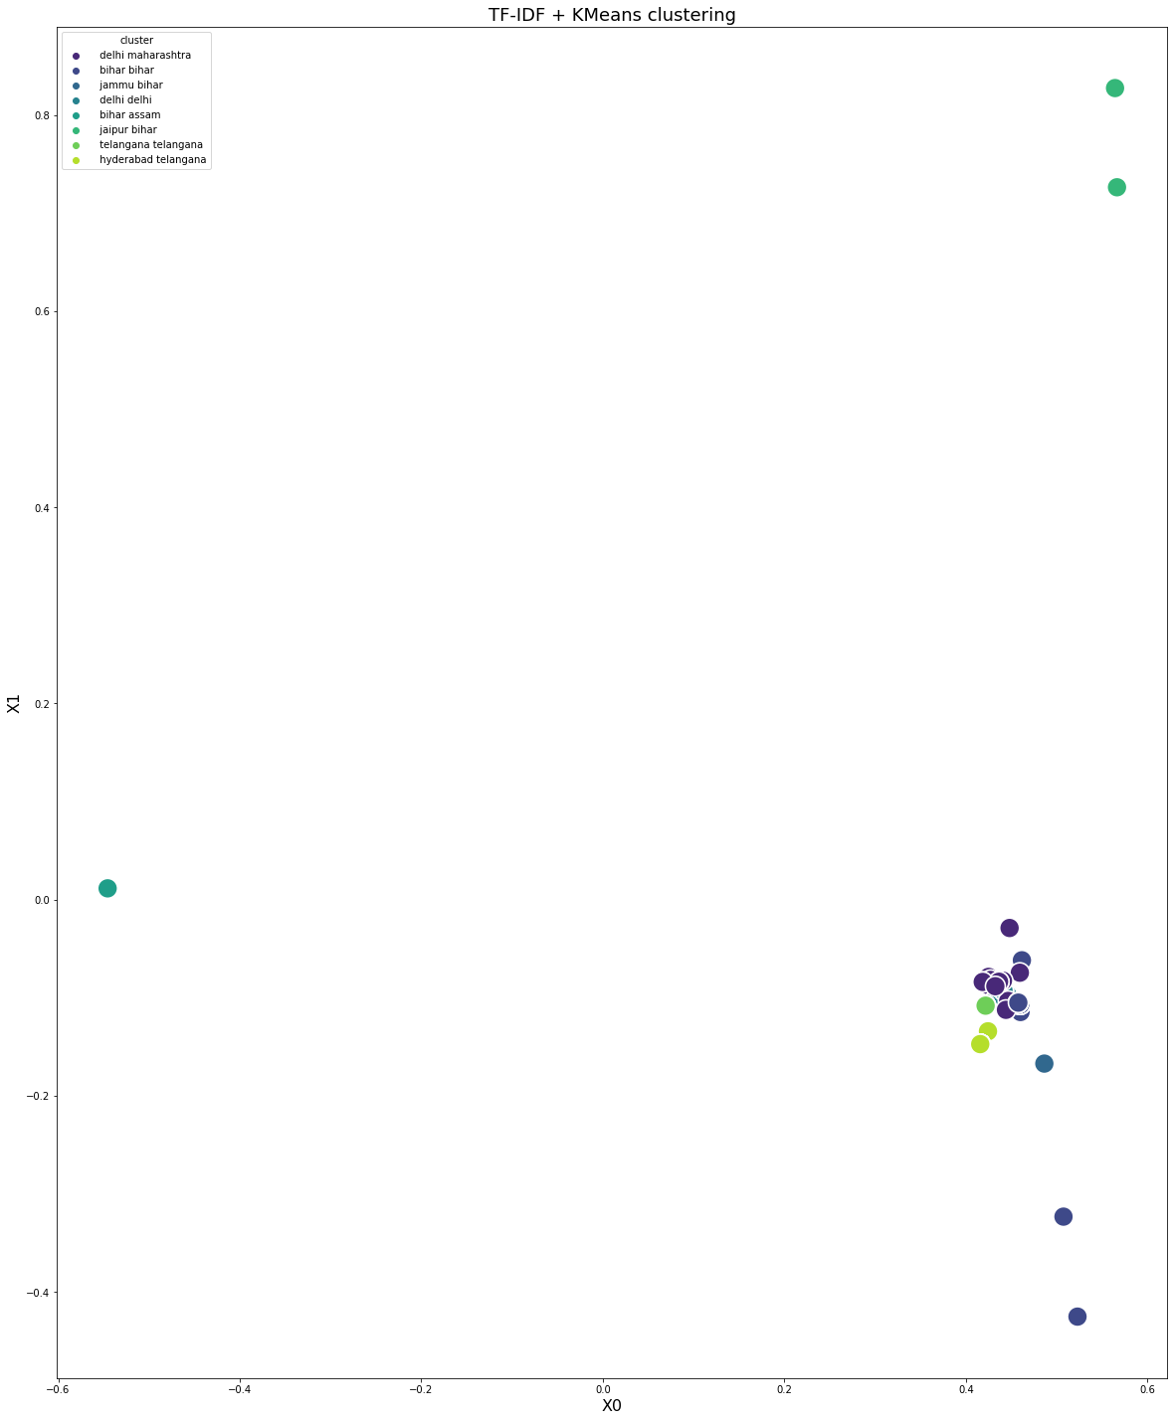
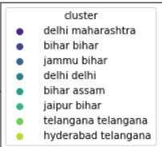
RESEARCH METHODS

Slide 10
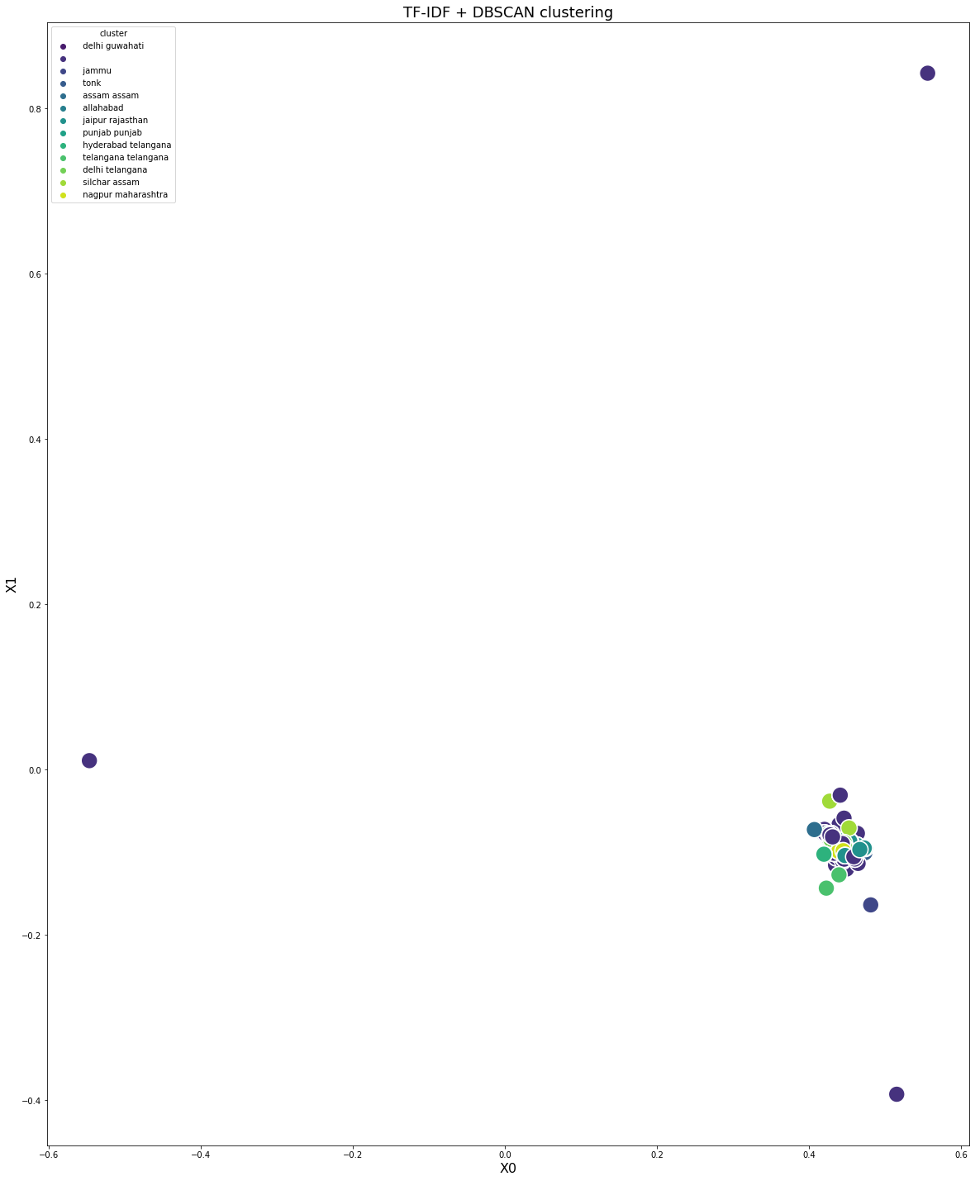
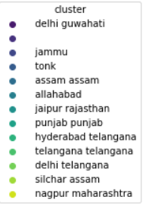
RESEARCH METHODS

Slide 11
RESEARCH METHODS
Image processing is done to check whether the image extracted is a flood image.
A open-source model (fine-tuned flood detection model) which is pre-trained using TensorFlow is used for image processing.
Images that are extracted from Tweets are tested using this model.

Slide 12
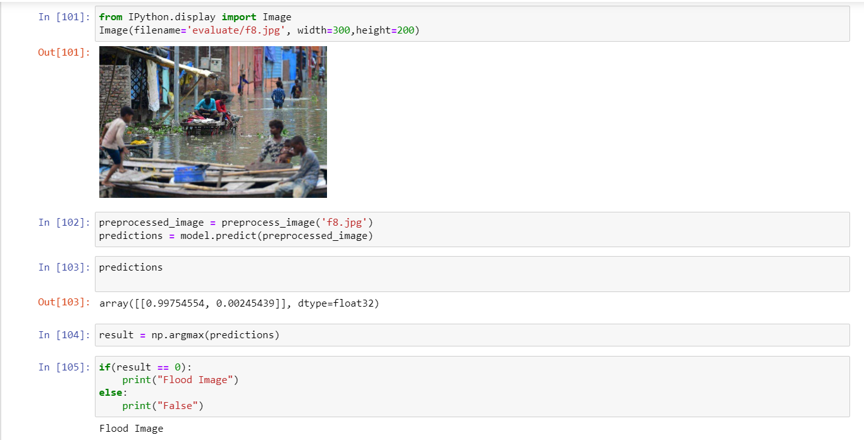
RESEARCH METHODS

Slide 13
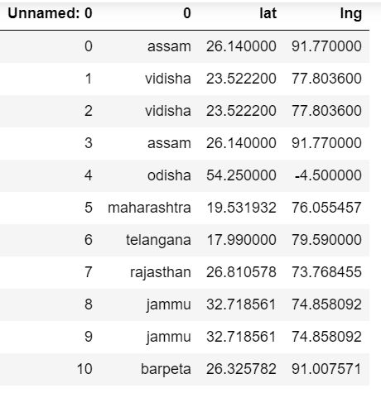
RESULTS
Mapquest API is an American free online web mapping service.
It is used to obtain the latitude and longitude of each location.

Slide 14
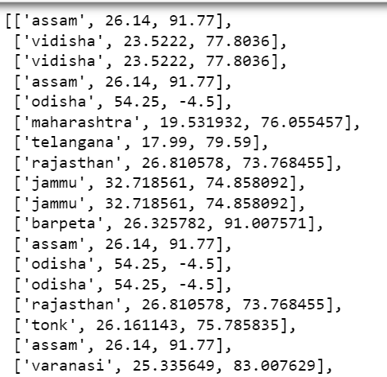
RESULTS
Folium is a powerful python library that helps to create maps.
A nested list containing Location, Latitude, and Longitude is created from Dataframe.
A function is defined that iterates this list and marks each location on the map.

Slide 15
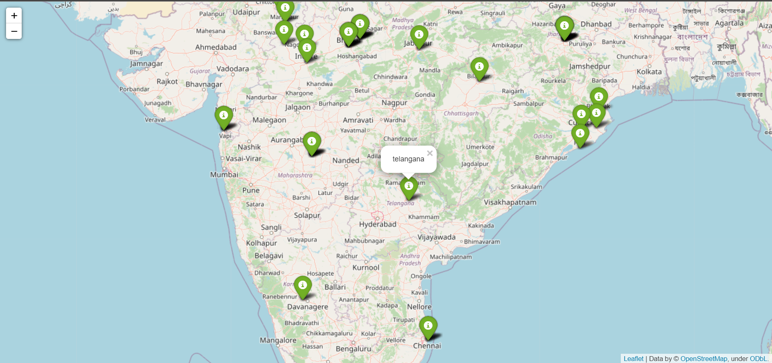

Slide 16
RESULTS
Data related to Temperature, Humidity, and Windspeed at the time of the event are collected from google by Web Scrapping.
Python library HTMLSession from requests_html is used for parsing HTML elements and obtaining necessary data.
A function is created that iterates through all the location and find their corresponding data.
This data is stored in the form of DataFrame which is used to map the regions with a popup.

Slide 17
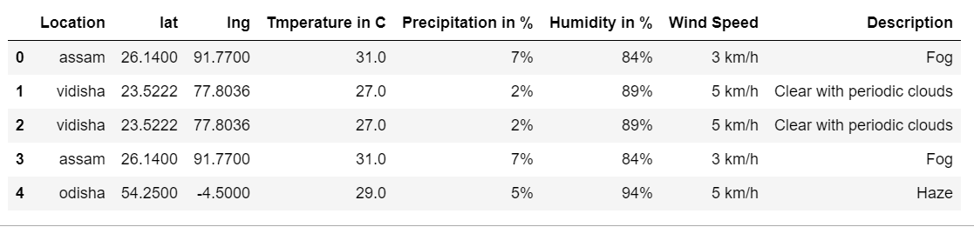
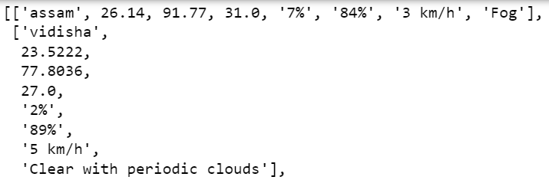
RESULTS
Dataframe is transformed into a list that contains location and its corresponding data.
A function is created which iterates this list and marks each location.
While marking, a popup is defined which has all the corresponding data.

Slide 18
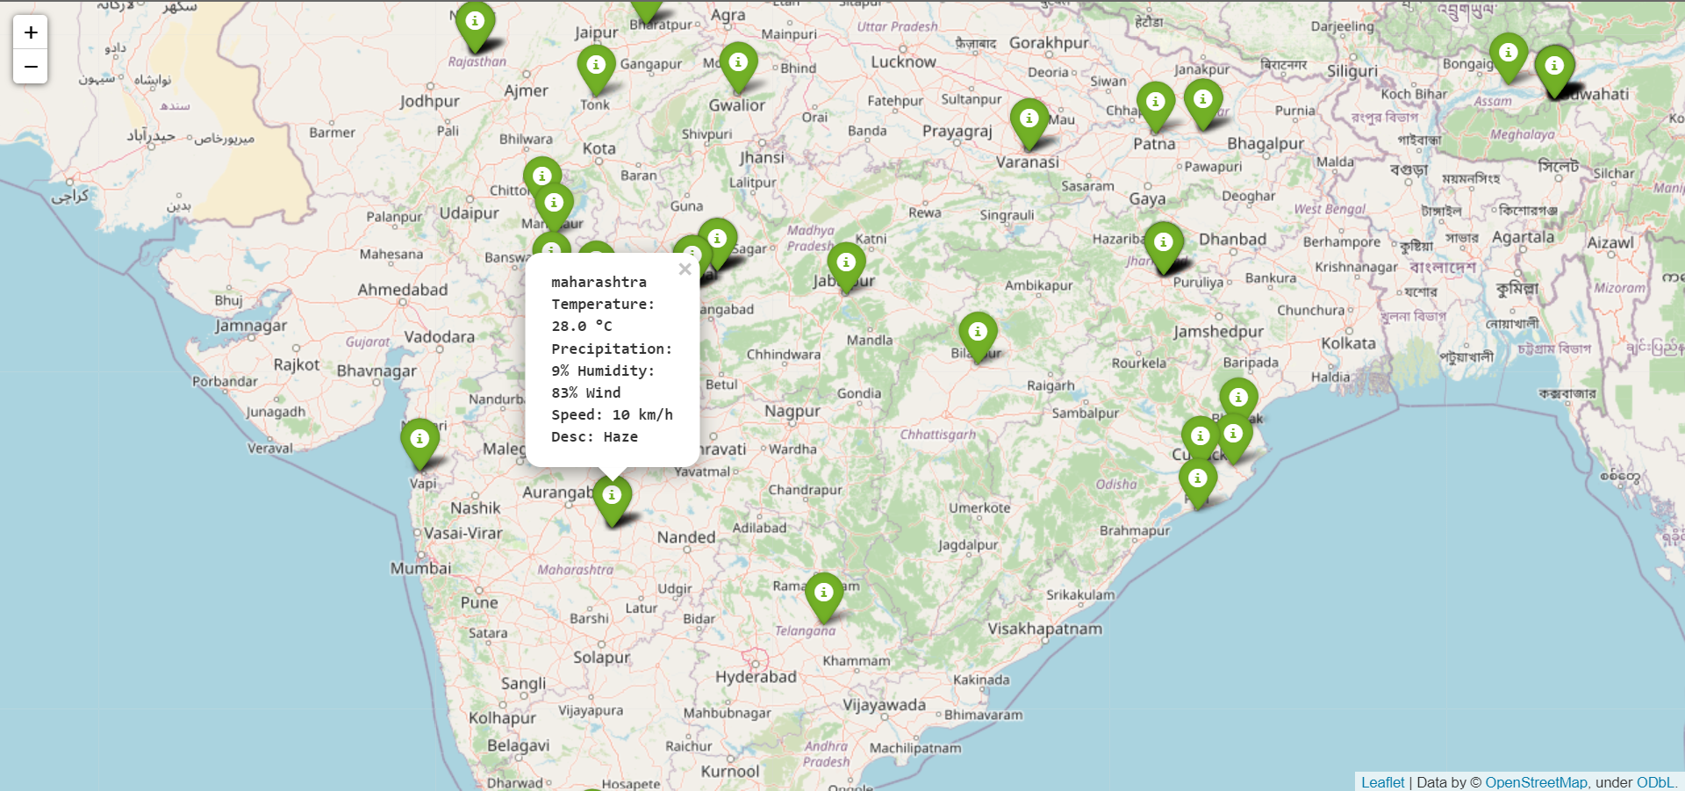

Slide 19
CONCLUSION
The analyzed data can be stored which can be used in the Future.
Several inferences can be derived from these data to study the flood pattern.
These inferences are useful to forecast future floods and take preventive measures.
By analyzing this data continuously, flood-prone regions can be identified and Government can take mitigation steps.

Slide 20
FUTURE SCOPE
This map can be incorporated into Google Maps to show the flooded regions to the user.
The routes which are flooded can also be indicated so that users can plan the route accordingly.
A Flood GIS database can be created and it could be maintained by the Government.

Slide 21
REFERENCES
A framework for massive Twitter data extraction and analysis Article in Malaysian Journal of Computer Science · January 2014, David F.Barero
https://python-visualization.github.io/folium/quickstart.html
https://developer.mapquest.com/documentation/
https://www.youtube.com/watch?v=cta1yCb3vA8&t=576s
https://www.analyticsvidhya.com/blog/2021/05/geospatial-visualization-via-folium-library/

